Slide 1
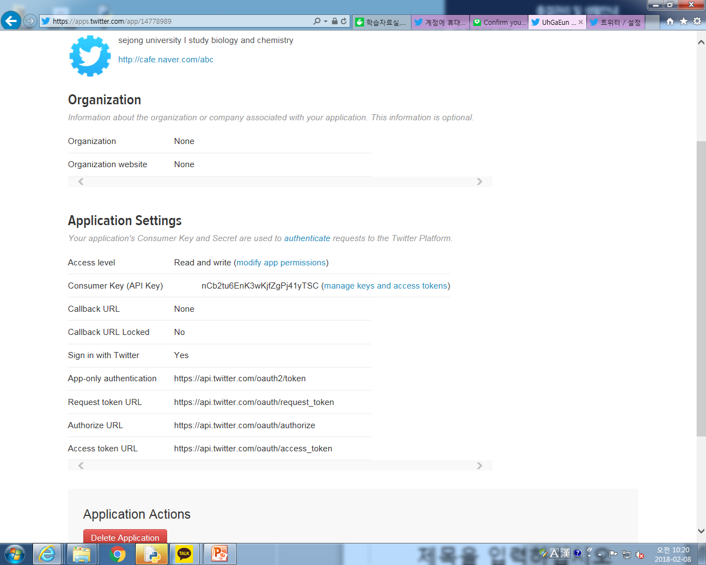

Slide 2
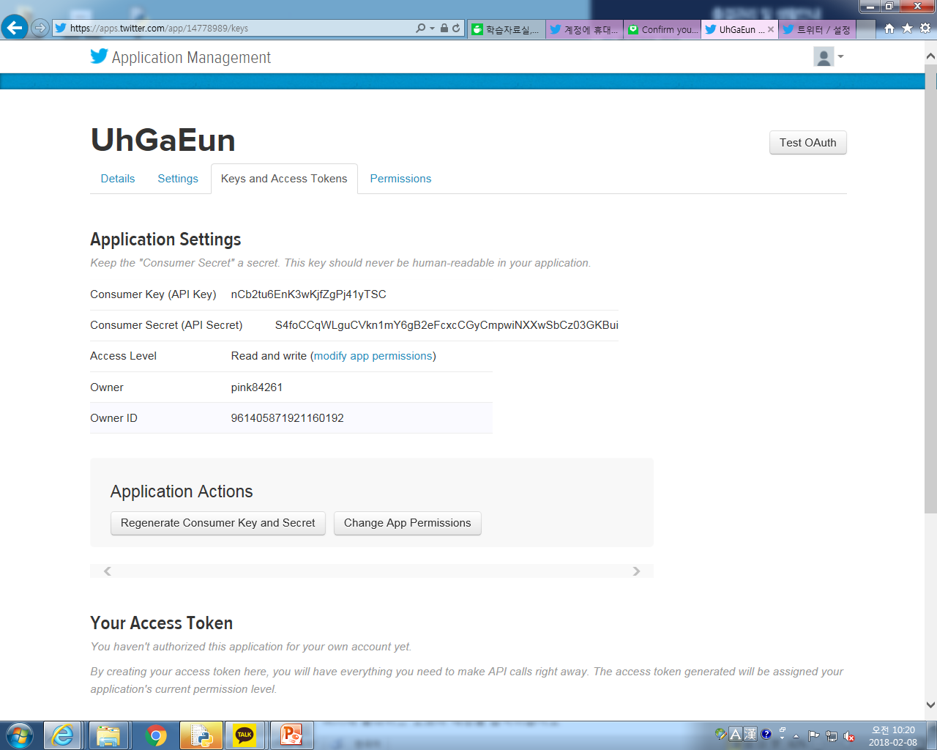

Slide 3
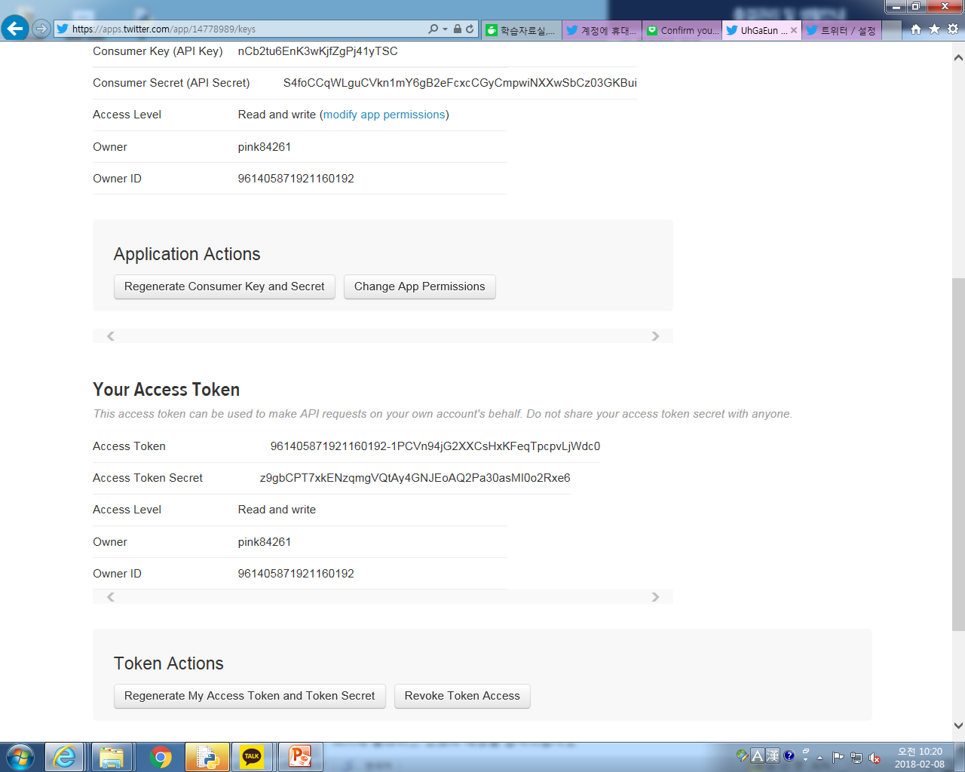
Notes:
Access Token 961405871921160192-1PCVn94jG2XXCsHxKFeqTpcpvLjWdc0
Access Token Secret z9gbCPT7xkENzqmgVQtAy4GNJEoAQ2Pa30asMI0o2Rxe6

Slide 4
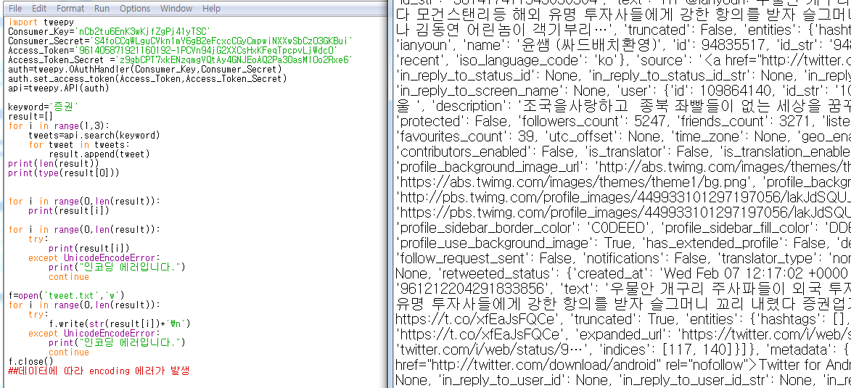
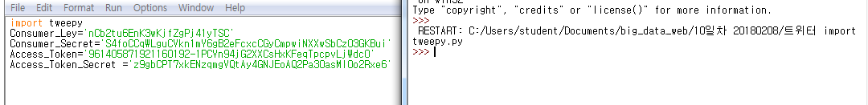
트위터 개발자 크롤링해오기
Notes:
import tweepy
Consumer_Key='nCb2tu6EnK3wKjfZgPj41yTSC'
Consumer_Secret='S4foCCqWLguCVkn1mY6gB2eFcxcCGyCmpwiNXXwSbCz03GKBui'
Access_Token='961405871921160192-1PCVn94jG2XXCsHxKFeqTpcpvLjWdc0'
Access_Token_Secret ='z9gbCPT7xkENzqmgVQtAy4GNJEoAQ2Pa30asMI0o2Rxe6'
auth=tweepy.OAuthHandle(Consumer_Key,Consumer_Secret)
auth.set_access_token(Access_Token,Access_Token_Secret)
api=tweepy.API(auth)

Slide 5
Notes:
import tweepy
Consumer_Key='nCb2tu6EnK3wKjfZgPj41yTSC'
Consumer_Secret='S4foCCqWLguCVkn1mY6gB2eFcxcCGyCmpwiNXXwSbCz03GKBui'
Access_Token='961405871921160192-1PCVn94jG2XXCsHxKFeqTpcpvLjWdc0'
Access_Token_Secret ='z9gbCPT7xkENzqmgVQtAy4GNJEoAQ2Pa30asMI0o2Rxe6'
auth=tweepy.OAuthHandler(Consumer_Key,Consumer_Secret)
auth.set_access_token(Access_Token,Access_Token_Secret)
api=tweepy.API(auth)
keyword='증권'
result=[]
for i in range(1,3):
tweets=api.search(keyword)
for tweet in tweets:
result.append(tweet)
print(len(result))
print(type(result[0]))
for i in range(0,len(result)):
print(result[i])
for i in range(0,len(result)):
try:
print(result[i])
except UnicodeEncodeError:
print("인코딩 에러입니다.")
continue
f=open('tweet.txt','w')
for i in range(0,len(result)):
try:
f.write(str(result[i])+'\n')
except UnicodeEncodeError:
print("인코딩 에러입니다.")
continue
f.close()
##데이터에 따라 encoding 에러가 발생

Slide 6
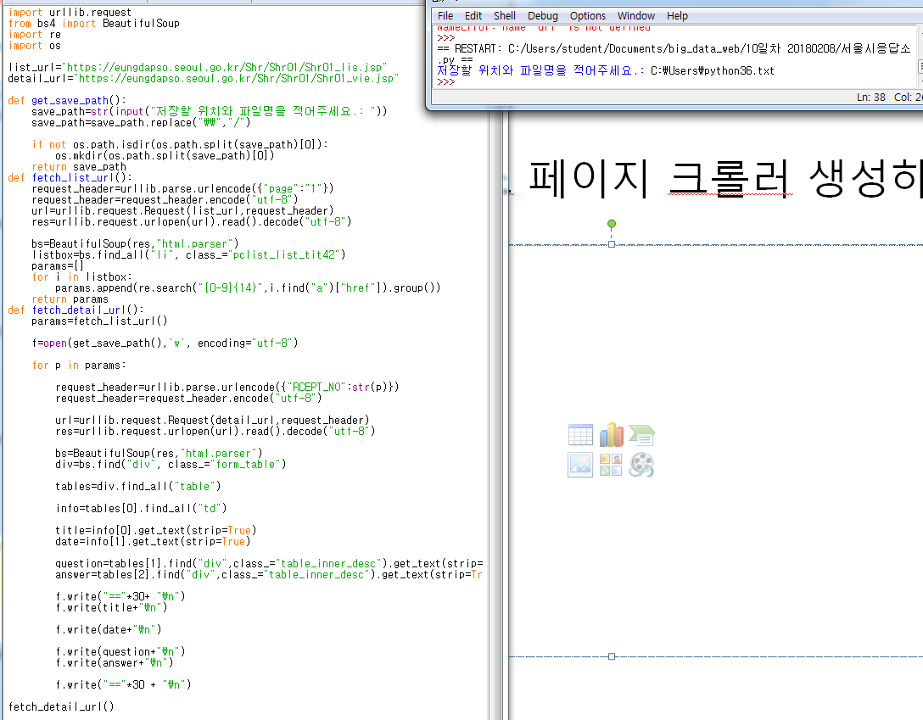
서울시 응답소 페이지 크롤러 생성하기
Notes:
import urllib.request
from bs4 import BeautifulSoup
import re
import os
list_url="https://eungdapso.seoul.go.kr/Shr/Shr01/Shr01_lis.jsp"
detail_url="https://eungdapso.seoul.go.kr/Shr/Shr01/Shr01_vie.jsp"
def get_save_path():
save_path=str(input("저장할 위치와 파일명을 적어주세요.: "))
save_path=save_path.replace("\\","/")
if not os.path.isdir(os.path.split(save_path)[0]):
os.mkdir(os.path.split(save_path)[0])
return save_path
def fetch_list_url():
request_header=urllib.parse.urlencode({"page":"1"})
request_header=request_header.encode("utf-8")
url=urllib.request.Request(list_url,request_header)
res=urllib.request.urlopen(url).read().decode("utf-8")
bs=BeautifulSoup(res,"html.parser")
listbox=bs.find_all("li", class_="pclist_list_tit42")
params=[]
for i in listbox:
params.append(re.search("[0-9]{14}",i.find("a")["href"]).group())
return params
def fetch_detail_url():
params=fetch_list_url()
f=open(get_save_path(),'w', encoding="utf-8")
for p in params:
request_header=urllib.parse.urlencode({"RCEPT_NO":str(p)})
request_header=request_header.encode("utf-8")
url=urllib.request.Request(detail_url,request_header)
res=urllib.request.urlopen(url).read().decode("utf-8")
bs=BeautifulSoup(res,"html.parser")
div=bs.find("div", class_="form_table")
tables=div.find_all("table")
info=tables[0].find_all("td")
title=info[0].get_text(strip=True)
date=info[1].get_text(strip=True)
question=tables[1].find("div",class_="table_inner_desc").get_text(strip=True)
answer=tables[2].find("div",class_="table_inner_desc").get_text(strip=True)
f.write("=="*30+ "\n")
f.write(title+"\n")
f.write(date+"\n")
f.write(question+"\n")
f.write(answer+"\n")
f.write("=="*30 + "\n")
fetch_detail_url()

Slide 7
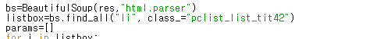
페이지 바꾸기 tit42

Slide 8
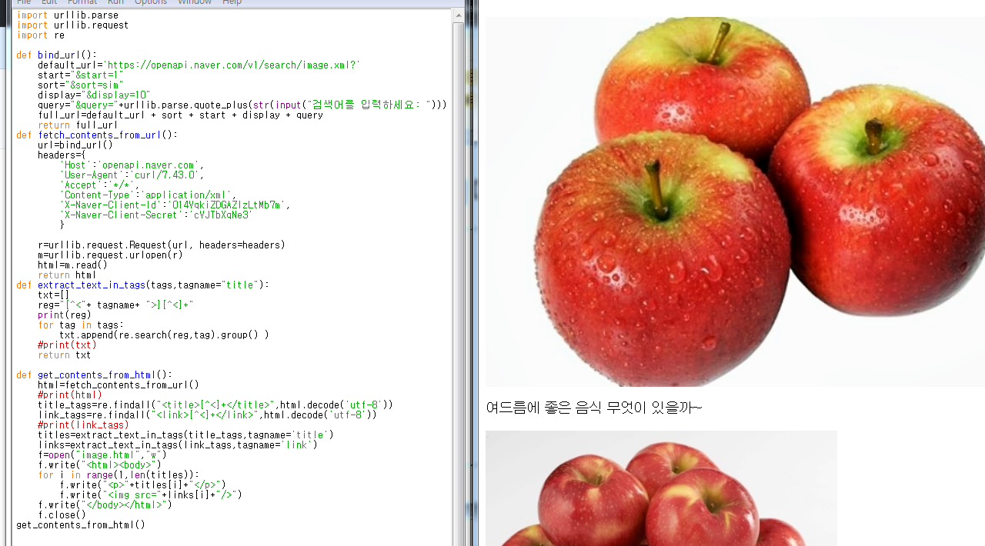
이미지 크롤링 print 바꾸기 전 원본
Notes:
import urllib.parse
import urllib.request
import re
def bind_url():
default_url='https://openapi.naver.com/v1/search/image.xml?'
start="&start=1"
sort="&sort=sim"
display="&display=10"
query="&query="+urllib.parse.quote_plus(str(input("검색어를 입력하세요: ")))
full_url=default_url + sort + start + display + query
return full_url
def fetch_contents_from_url():
url=bind_url()
headers={
'Host':'openapi.naver.com',
'User-Agent':'curl/7.43.0',
'Accept':'*/*',
'Content-Type':'application/xml',
'X-Naver-Client-Id':'014VqkiZDGAZIzLtMb7m',
'X-Naver-Client-Secret':'cVJTbXqNe3'
}
r=urllib.request.Request(url, headers=headers)
m=urllib.request.urlopen(r)
html=m.read()
return html
def extract_text_in_tags(tags,tagname="title"):
txt=[]
reg="[^<"+ tagname+ ">][^<]+"
print(reg)
for tag in tags:
txt.append(re.search(reg,tag).group() )
#print(txt)
return txt
def get_contents_from_html():
html=fetch_contents_from_url()
#print(html)
title_tags=re.findall("<title>[^<]+</title>",html.decode('utf-8'))
link_tags=re.findall("<link>[^<]+</link>",html.decode('utf-8'))
#print(link_tags)
titles=extract_text_in_tags(title_tags,tagname='title')
links=extract_text_in_tags(link_tags,tagname='link')
f=open("image.html","w")
f.write("<html><body>")
for i in range(1,len(titles)):
f.write("<p>"+titles[i]+"</p>")
f.write("<img src="+links[i]+"/>")
f.write("</body></html>")
f.close()
get_contents_from_html()

Slide 9
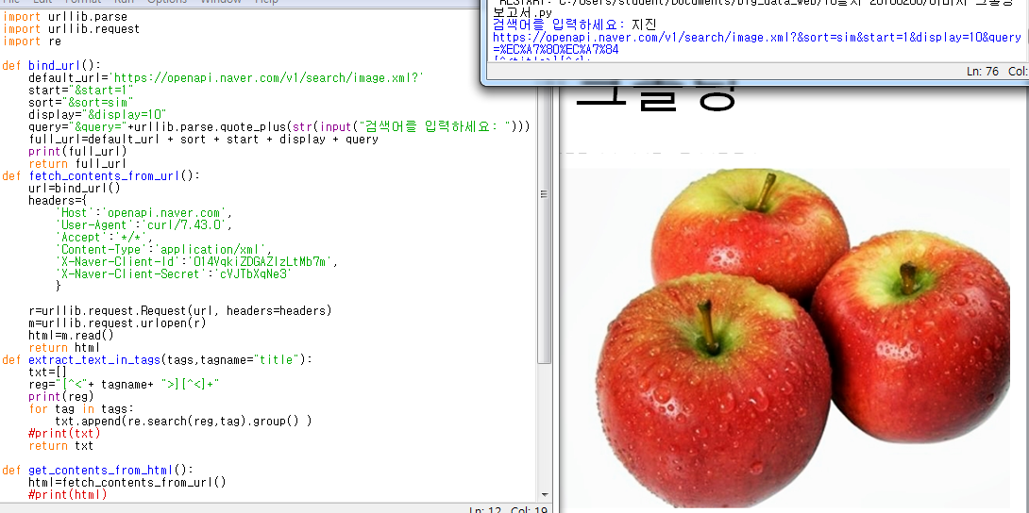
Print(full_url) 추가
Notes:
import urllib.parse
import urllib.request
import re
def bind_url():
default_url='https://openapi.naver.com/v1/search/image.xml?'
start="&start=1"
sort="&sort=sim"
display="&display=10"
query="&query="+urllib.parse.quote_plus(str(input("검색어를 입력하세요: ")))
full_url=default_url + sort + start + display + query
print(full_url)
return full_url
def fetch_contents_from_url():
url=bind_url()
headers={
'Host':'openapi.naver.com',
'User-Agent':'curl/7.43.0',
'Accept':'*/*',
'Content-Type':'application/xml',
'X-Naver-Client-Id':'014VqkiZDGAZIzLtMb7m',
'X-Naver-Client-Secret':'cVJTbXqNe3'
}
r=urllib.request.Request(url, headers=headers)
m=urllib.request.urlopen(r)
html=m.read()
return html
def extract_text_in_tags(tags,tagname="title"):
txt=[]
reg="[^<"+ tagname+ ">][^<]+"
print(reg)
for tag in tags:
txt.append(re.search(reg,tag).group() )
#print(txt)
return txt
def get_contents_from_html():
html=fetch_contents_from_url()
#print(html)
title_tags=re.findall("<title>[^<]+</title>",html.decode('utf-8'))
link_tags=re.findall("<link>[^<]+</link>",html.decode('utf-8'))
#print(link_tags)
titles=extract_text_in_tags(title_tags,tagname='title')
links=extract_text_in_tags(link_tags,tagname='link')
f=open("image.html","w")
f.write("<html><body>")
for i in range(1,len(titles)):
f.write("<p>"+titles[i]+"</p>")
f.write("<img src="+links[i]+"/>")
f.write("</body></html>")
f.close()
get_contents_from_html()

Slide 10
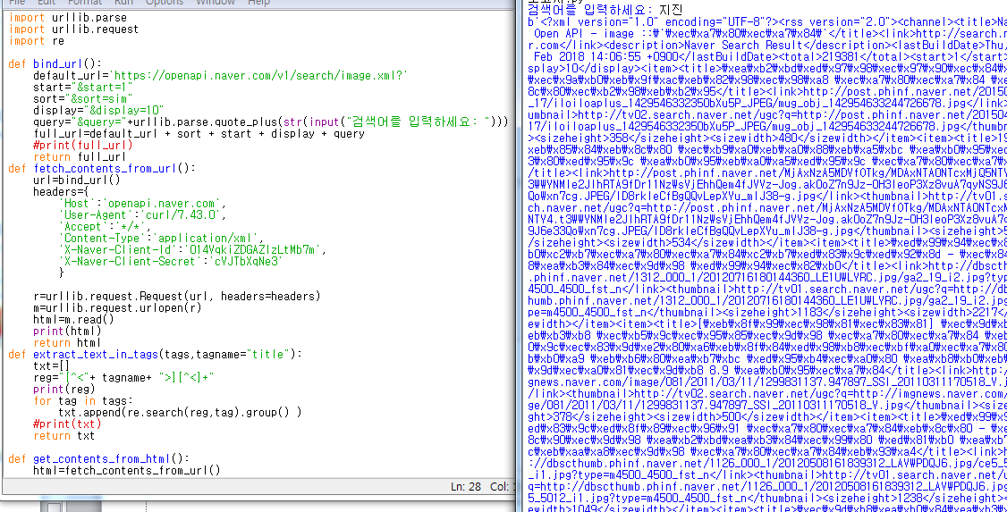
Print(html) 추가-보려고
Notes:
import urllib.parse
import urllib.request
import re
def bind_url():
default_url='https://openapi.naver.com/v1/search/image.xml?'
start="&start=1"
sort="&sort=sim"
display="&display=10"
query="&query="+urllib.parse.quote_plus(str(input("검색어를 입력하세요: ")))
full_url=default_url + sort + start + display + query
#print(full_url)
return full_url
def fetch_contents_from_url():
url=bind_url()
headers={
'Host':'openapi.naver.com',
'User-Agent':'curl/7.43.0',
'Accept':'*/*',
'Content-Type':'application/xml',
'X-Naver-Client-Id':'014VqkiZDGAZIzLtMb7m',
'X-Naver-Client-Secret':'cVJTbXqNe3'
}
r=urllib.request.Request(url, headers=headers)
m=urllib.request.urlopen(r)
html=m.read()
print(html)
return html
def extract_text_in_tags(tags,tagname="title"):
txt=[]
reg="[^<"+ tagname+ ">][^<]+"
print(reg)
for tag in tags:
txt.append(re.search(reg,tag).group() )
#print(txt)
return txt
def get_contents_from_html():
html=fetch_contents_from_url()
#print(html)
title_tags=re.findall("<title>[^<]+</title>",html.decode('utf-8'))
link_tags=re.findall("<link>[^<]+</link>",html.decode('utf-8'))
#print(link_tags)
titles=extract_text_in_tags(title_tags,tagname='title')
links=extract_text_in_tags(link_tags,tagname='link')
f=open("image.html","w")
f.write("<html><body>")
for i in range(1,len(titles)):
f.write("<p>"+titles[i]+"</p>")
f.write("<img src="+links[i]+"/>")
f.write("</body></html>")
f.close()
get_contents_from_html()

Slide 11
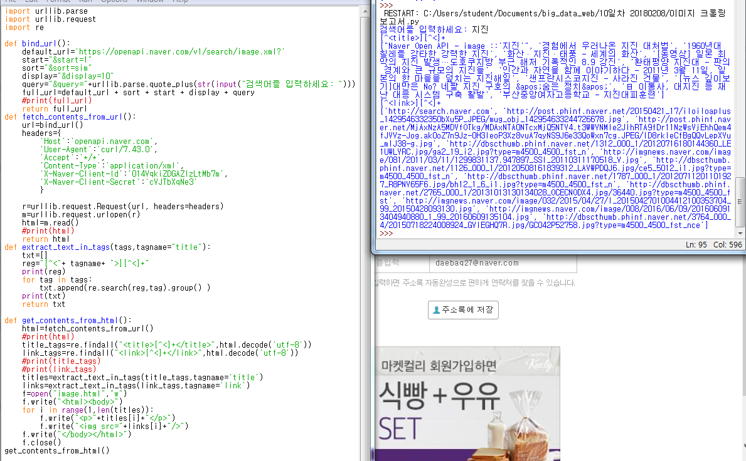
Print(txt) 추가

Slide 12
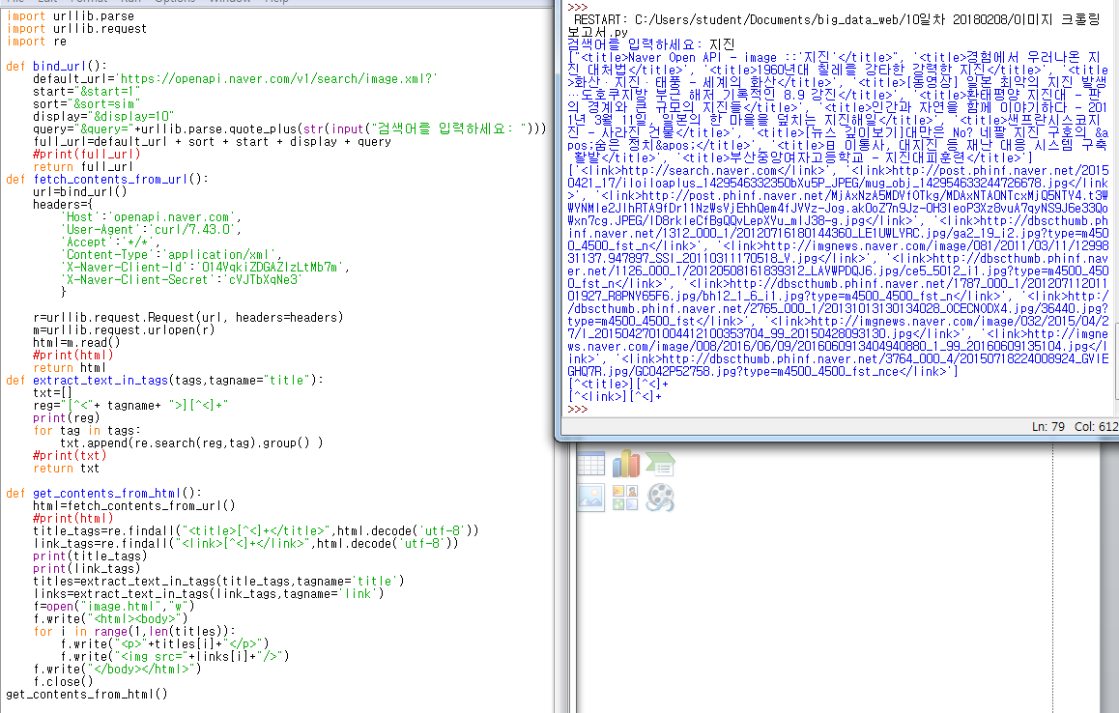
Print(title_tags) print(link_tags) 추가

Slide 13
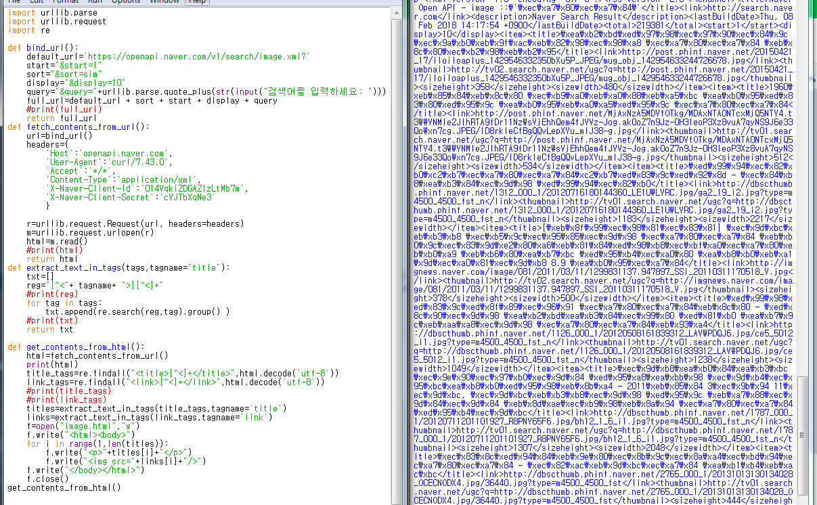
아래 print(html) 추가

